Slide 1
Intensive farming
Léo LECLERRE Florian MOSNIER

Slide 2
Table of contents
Definition I - History II - Intensive livestock farming III - Intensive crop farming
Conclusion

Slide 3
Definition
“Intensive agriculture : farming that uses a lot of machinery, labour, chemicals, etc. in order to grow as many crops or keep as many animals as possible on the amount of land available” (Cambridge Dictionnary)
Définition
History
Livestock Farming
Crops Farming
Conclusion

Slide 4
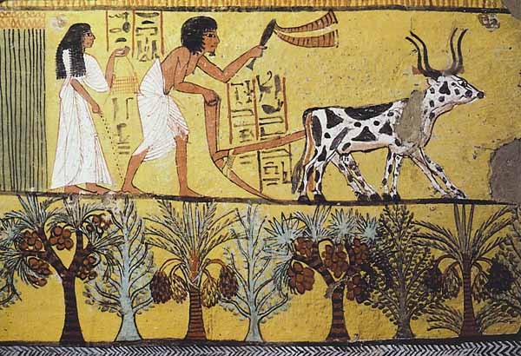
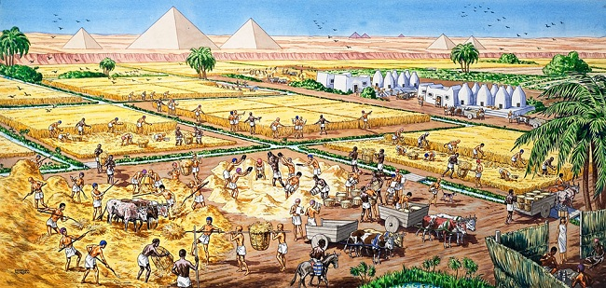
Intensive farming : a new concept?
Painting of Egyptian plowing his field
How Egyptian agriculture could look like

Slide 5
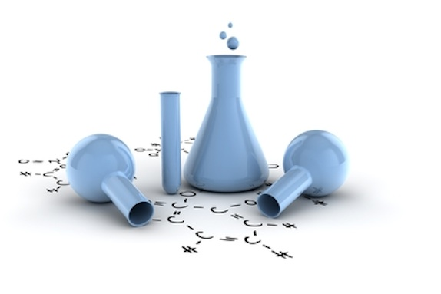
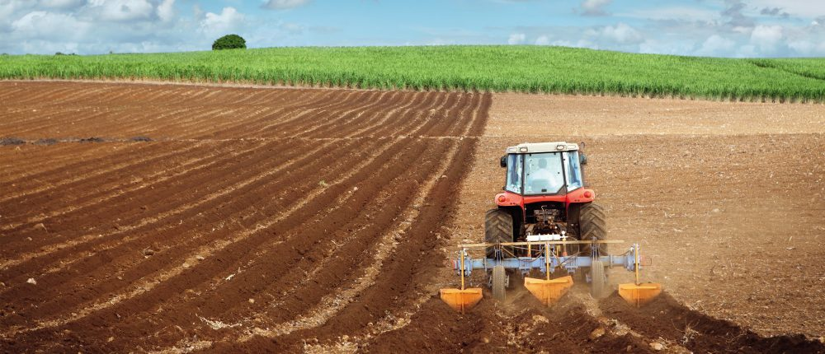
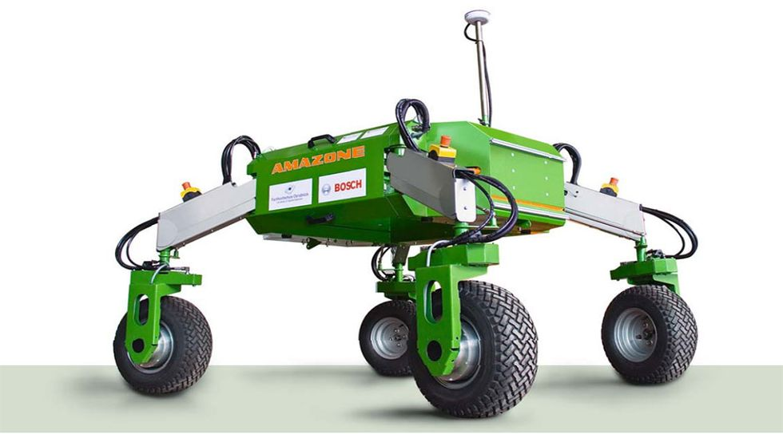
I- History
Chemical products (fertilizers)
After WWII
Help to a booming human population
Mechanization
New technologies
https://www.aiche.org/sites/default/files/images/webinar/global_chemicals-materials-beeker-chemical-formula-v1834481.jpg
https://expertise.boschrexroth.fr/wp-content/uploads/2016/07/mecanisation_agricole-1000x430.jpg
http://www.entraid.com/wp-content/uploads/2016/10/bonirob.jpg
Définition
History
Livestock Farming
Crops Farming
Conclusion
Notes:
Fertilizer :
Nitrogen : 1913, Haber-Bosch process
Potassium : from the nature
Phosphorus : 1867 from phosphorus rock
A lot of men died during WWII : need a lot of food
New technologies : to have a global approach on field

Slide 6
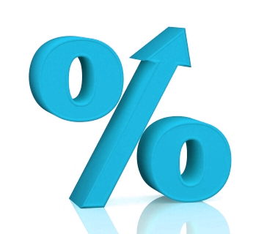

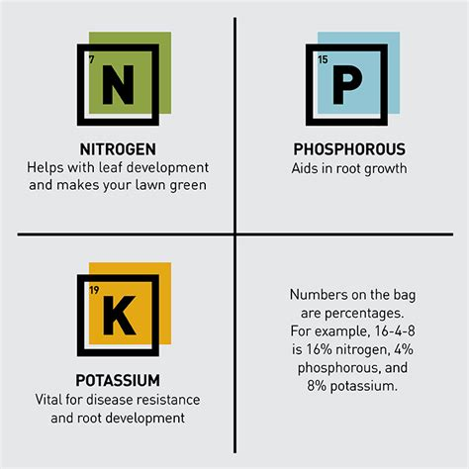
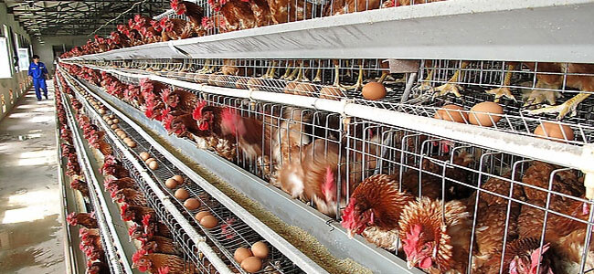
Intensive farming ?
http://etfdailynews.com/wp-content/uploads/2016/08/high-yield.png
High-Yield Farming
Lower Food Prices
Poor Living Conditions for Livestock
Excessive Use of Fertilizers and Pesticides
https://maxcdn.icons8.com/Share/icon/Ecommerce/low_price1600.png
https://www.china-chickencage.com/wp-content/uploads/Poultry-cage.jpg
http://www.lowes.com/projects/images/buying-guides/Lawn-Landscaping/fertilizer-buying-guide-inline-npk.jpg
Définition
History
Livestock Farming
Crops Farming
Conclusion
Notes:
Why intensive farming :
Advantages : High-yield farming
Disavantages : Fertilizers (NPK), pesticides

Slide 7
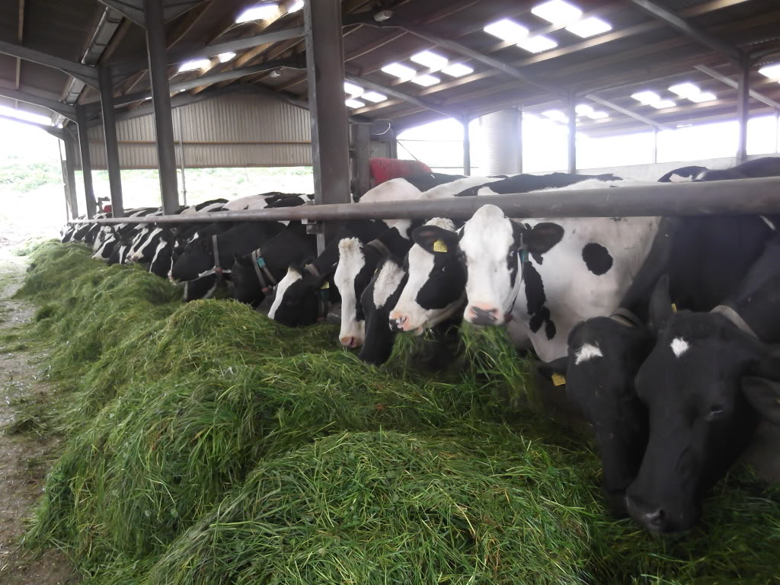
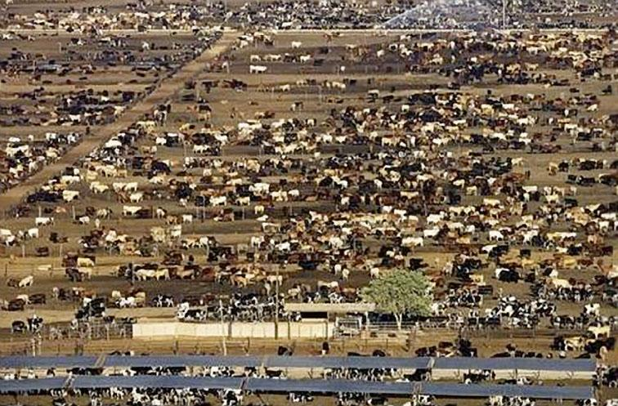
II- Intensive livestock farming
Animal
---------- = ⇗
Area
Lot of animals on a small area
Often zero grazing
Feedlots
Cheaper products
http://vincenttractors.co.uk/wp-content/uploads/2015/07/Cows-zero-grazing.jpg
http://pixdaus.com/files/items/pics/4/25/299425_d9a83cab2ffce4d1a2056560f12eb60b_large.jpg
Définition
History
Livestock Farming
Crops Farming
Conclusion

Slide 8
II- Intensive livestock farming
FaoStats
Définition
History
Livestock Farming
Crops Farming
Conclusion
Notes:
Have a look on the paper

Slide 9
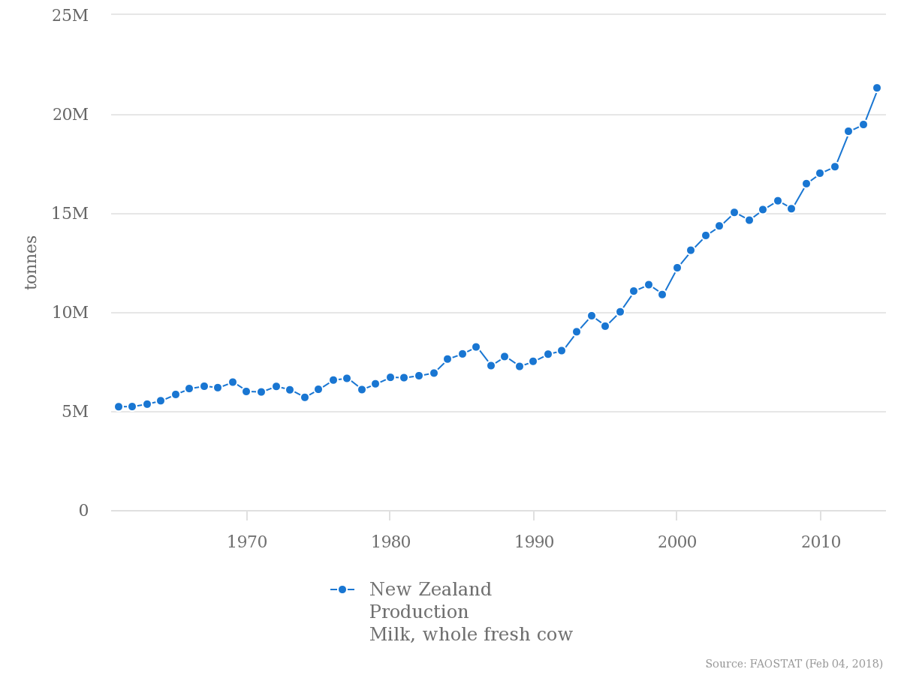
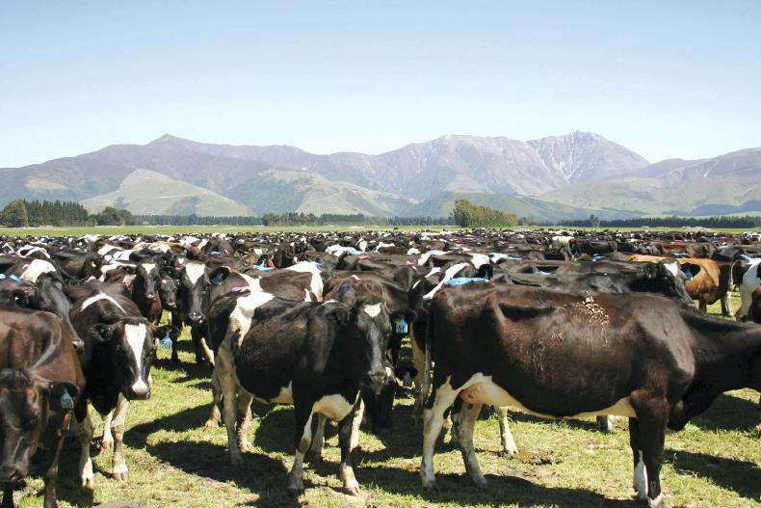
New Zealand milk production
→ 9 331 000 heads of cattle in 2014
→ Pasture all year long
→ 3000 L of water = 1 L of milk
http://www.farmersjournal.ie/WEBFILES/000/248/278/615595-248278.jpg
Définition
History
Livestock Farming
Crops Farming
Conclusion
Notes:
Explain the problems in New Zealand
For the graph, have a look on the paper

Slide 10

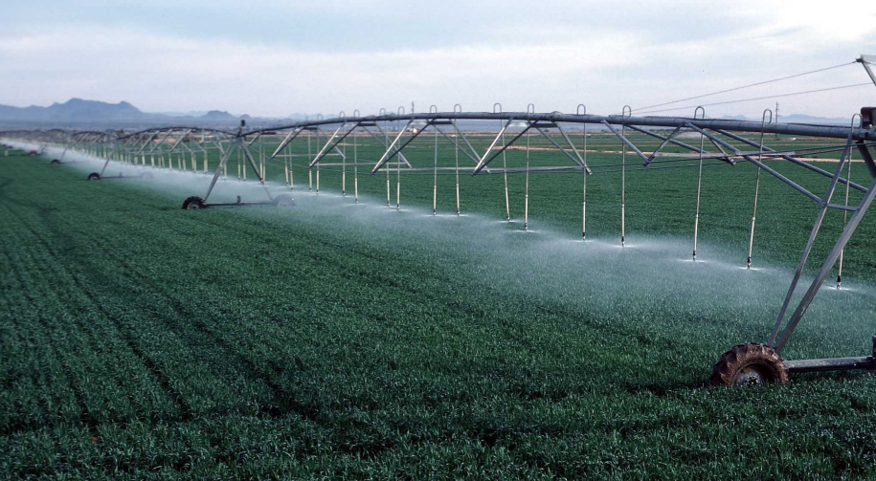

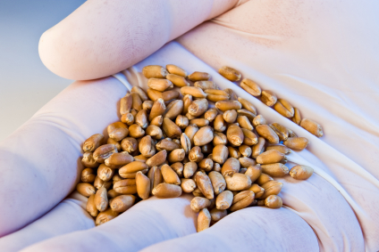
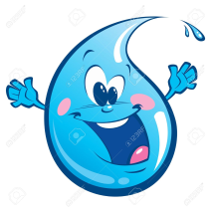
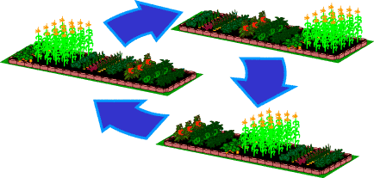

III- Intensive crop farming
High amount of pesticides and fertilizers
Massive irrigation
Genetically modified seeds
(Crop rotation)
https://www.flickr.com/photos/48722974@N07/5250023362
https://www.huffingtonpost.com
http://www.ourveggiegarden.com/AnPlanRotation.html
Définition
History
Livestock Farming
Crops Farming
Conclusion

Slide 11
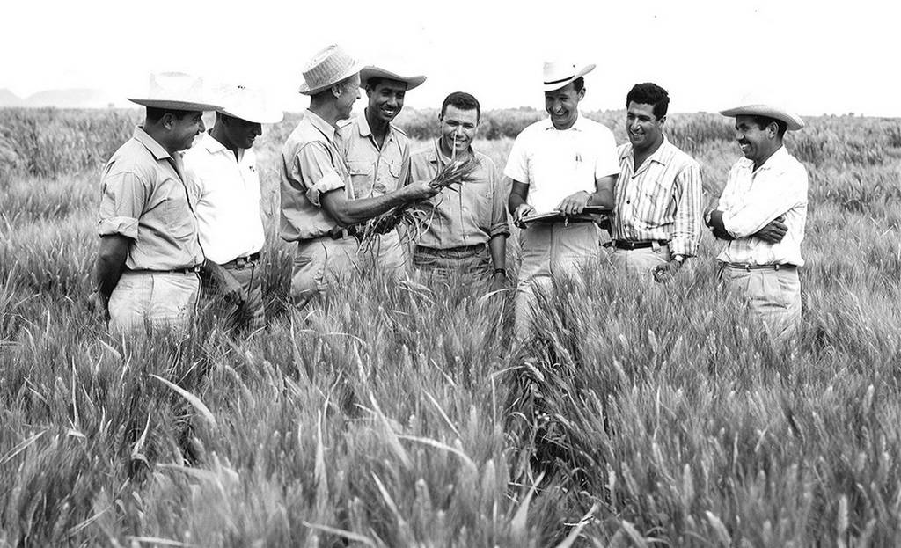
III- Intensive crop farming
The Green Revolution: a significant boost
“The Green Revolution is the ongoing transformation of agriculture that led in some places to significant increases in agricultural production between the 1940s and 1960s.”
www.nationencyclopedia.com
1944: Green revolution in Mexico
Norman Borlaug teaching a group of Mexican farmers
Définition
History
Livestock Farming
Crops Farming
Conclusion

Slide 12
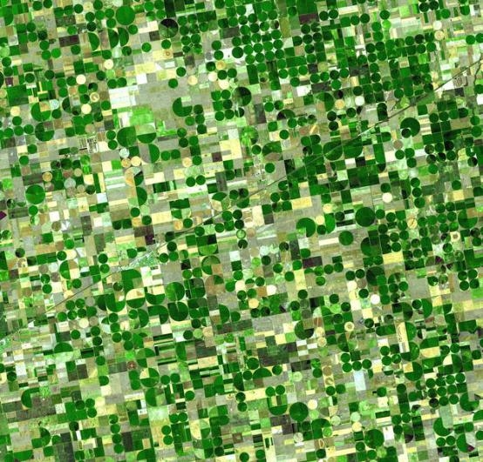
A computer component ?
https://en.wikipedia.org/wiki/File:Crops_Kansas_AST_20010624.jpg
Définition
History
Livestock Farming
Crops Farming
Conclusion

Slide 13
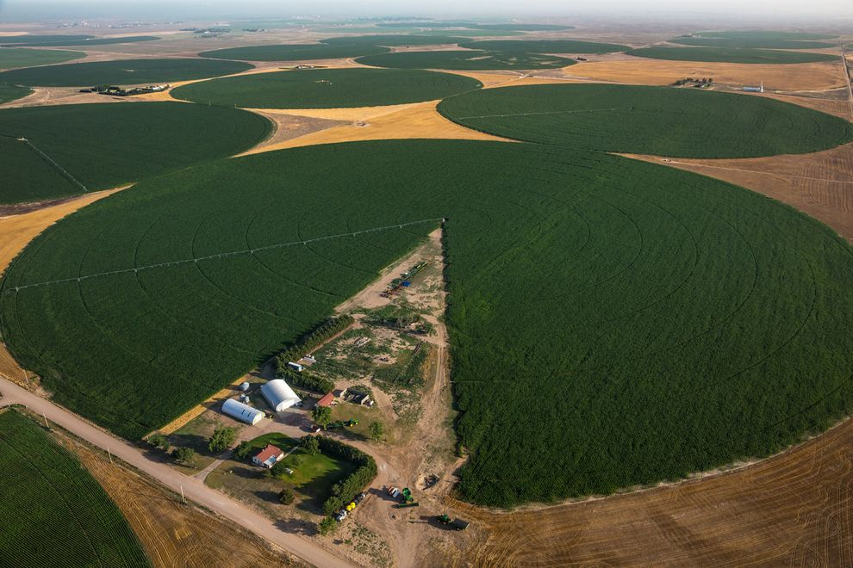
Center pivot irrigation
Kansas, United-States of America
Définition
History
Livestock Farming
Crops Farming
Conclusion

Slide 14
Conclusion
High production to feed people increasing
Some advantages / disadvantages
Mechanization : big buildings & machines
Définition
History
Livestock Farming
Crops Farming
Conclusion
Notes:
Advantages : system produces food cheaper and in a lot of quantity !
Disadvantages : system needs a lot of input and energy to work

Slide 15
Sources
https://www.britannica.com/topic/intensive-agriculture
http://www.fao.org
http://www.fao.org/faostat/en/#data
http://www.farmmanagement.pro/advantages-and-disadvantages-of-intensive-farming/
https://www.britannica.com/topic/livestock-farming
https://en.wikipedia.org/wiki/Intensive_farming
http://www.everythingconnects.org/intensive-farming.html
https://www.buzzle.com/articles/advantages-and-disadvantages-for-intensive-farming.html
https://fr.scribd.com/document/271653407/Agriculture-and-Timeline

Slide 16
Thank you for your attention
Do you have any questions ?

